Slide 1
The European Parliament
Composition
History
Powers

Slide 2

The origins
Traditionally, parliaments did not participate in the regional integration processes
Which remained under the governmental authority
National parliaments’ role → to approve the decisions of national executives
This changes with the European integration

Slide 3

The origins (II)
The changes in the role of parliaments in the European integration process had the following objectives:
Strengthening the popular and democratic nature of integration (legitimacy)
Underlining the different – more political and deeper – character of integration which is not only economic but also political
Counter-balancing the power of the executive
Involve in the integration process, in addition to the national dimension, the international one

Slide 4
The origins: the ECSC
The Schuman declaration did not include a parliamentary body – the idea came later
ECSC establishes the Common Assembly, elected indirectly and, mostly, with consultative competences: (however it can dismiss the High Authority)
The ECSC Treaty provides for the possibility of direct election
A failed effort : The ad hoc Assembly→ a constituent assembly for the Political Union of Europe

Slide 5
The origins (IV) – the European Economic Community Parliamentary Assembly
Indirect election (78 national MPs)
Hence a double mandate
Meeting periodically
With advisory opinion

Slide 6
The development – the gradual reinforcement
1961 – the EEC Assembly declared itself to be a 'Parliament' (the Treaties recognize this title only with the 1987 Single European Act)
1970 – is granted the competence to participate in the approval of the EEC budget (in 1975 it approves the entire budget)
1974 – European Parliament Elections Act
1979 – First direct elections by universal suffrage

Slide 7
The development – in search of new powers
1984: The Draft Treaty on European integration (Spinelli draft) – the efforts towards the federal transformation of the Community
1987: The Single European Act introduces the cooperation process, the first legislative competence of the EP1993: Maastricht Treaty – Introduction of co-decision, involvement in the election of the President of the Commission

Slide 8
The development – in search of new powers (II)
1997: Amsterdam Treaty – extension of co-decision, involvement in the election of the Commission president and the Commission members
2001 : Nice Treaty – simplification and extension of the co-decision
2009: Lisbon Treaty. The Parliament becomes a co-legislator

Slide 9
COMPOSITION
Article 10: Citizens are directly represented at Union level in the European Parliament
Article 14 para. 1: The European Parliament shall be composed of representatives of the Union's citizens
  (Until the Treaty of Lisbon): the European Parliament consists of representatives of the peoples of the States which have joined the community and exercises powers conferred on it by this Treaty.
The number of MEPs shall not exceed seven hundred and fifty plus the president
Representation of citizens shall be degressively proportional, with a minimum threshold of six members per Member State. No Member State shall be allocated more than ninety-six seats

Slide 10
EP seats by member state pre-Brexit

Slide 11
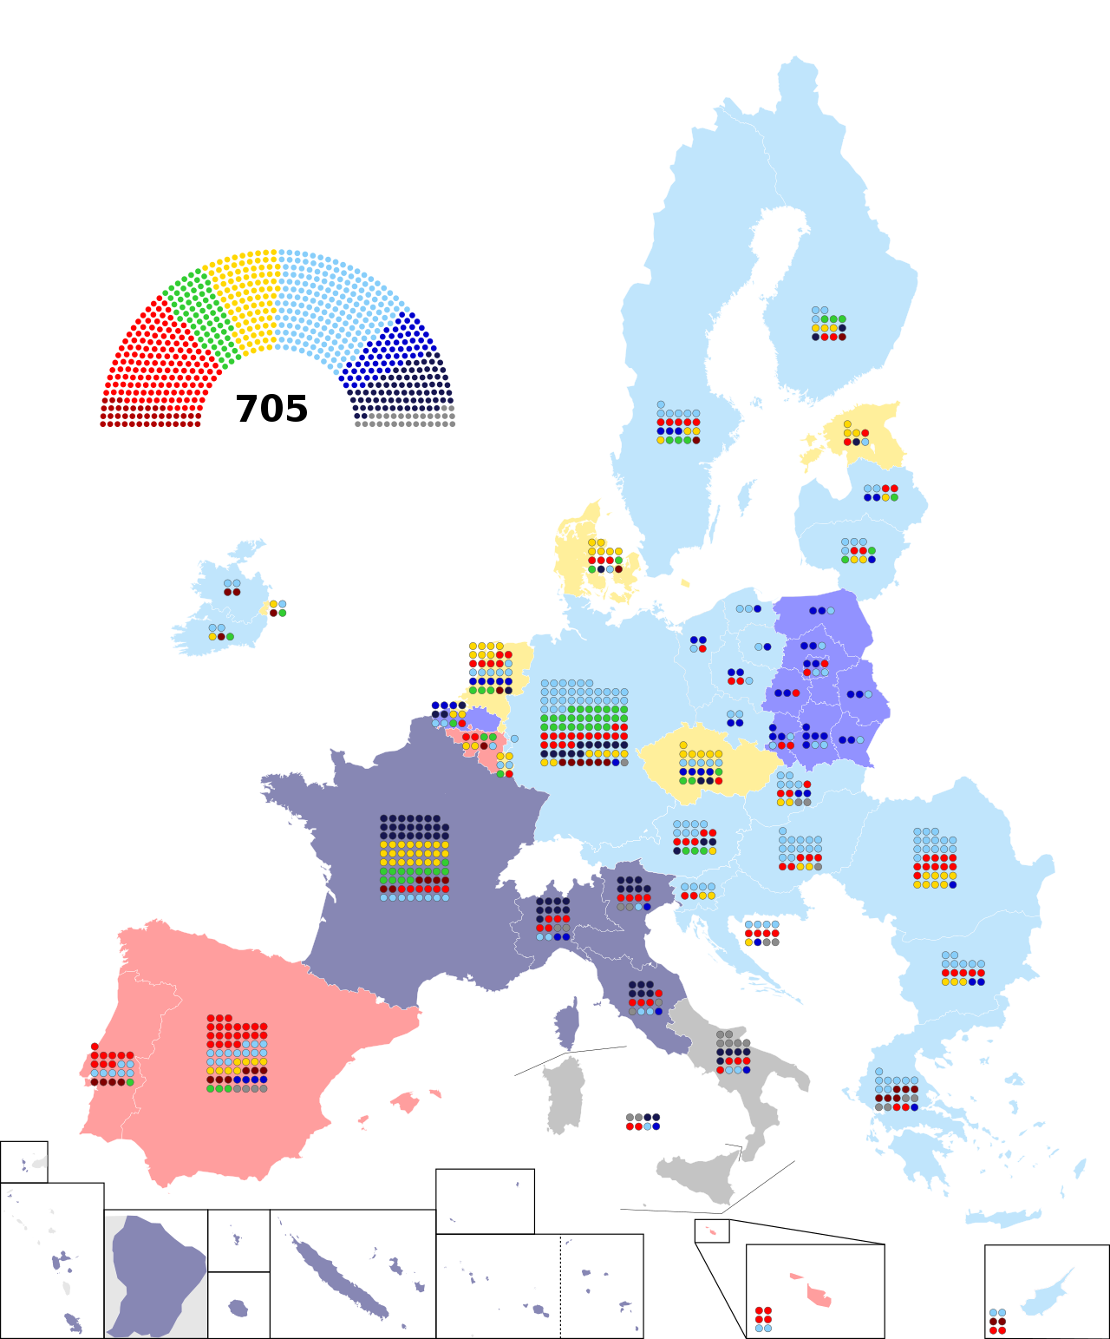
EP seats by Member State post-Brexit

Slide 12
The electoral system
The European Parliament shall draw up a proposal to lay down the provisions necessary for the election of its Members by direct universal suffrage in accordance with a uniform procedure in all Member States or in accordance with principles common to all Member States.
The Council, acting unanimously in accordance with a special legislative procedure and after obtaining the consent of the European Parliament, which shall act by a majority of its component Members, shall lay down the necessary provisions. These provisions shall enter into force following their approval by the Member States in accordance with their respective constitutional requirements.

Slide 13
COMPOSITION
Today 705 members of the European Parliament
Greece has 21 MEPs (in 2004 → 24)
The rule of the decreasing proportionality

Slide 14
COMPOSITION
The Members of the European Parliament are elected for five years by direct, universal, free and secret ballot.
It decides by simple majority (unless otherwise provided for in the Treaties)
2. The European Parliament, acting by means of regulations on its own initiative in accordance with a special legislative procedure after seeking an opinion from the Commission and with the consent of the Council, shall lay down the regulations and general conditions governing the performance of the duties of its Members. All rules or conditions relating to the taxation of Members or former Members shall require unanimity within the Council.

Slide 15
It has three seats
Originally the EP met in Strasbourg
While its administration was in Luxembourg.
After the direct election, committee meetings started taking place in Brussels
The current situation
  Administration → Luxembourg
  12 plenary sessions → Strasbourg
  Committees and other plenary sittings → Brussels
The Parliament’s demand for a single seat
Clashes with member states (particularly France) interests

Slide 16
STRUCTURE
President (elected for 2 1/2 years)
Bureau
Conference of Presidents of parliamentary groups
Parliamentary committees
Parliamentary delegations
The use of the D’Hondt system for the allocation of all positions

Slide 17
The statute of MEPs
The election takes place at national level, based on different electoral systems (all member states now use some form of proportional representation)
Until 2009 MEPs received a differentiated compensation, matching that of respective national MPs
The single statute of parliamentarians was initiated only in 2009 ➔ same salary and tax treatment, privileges and immunities –)

Slide 18
European political parties
«Political parties at European level contribute to forming European political awareness and to expressing the will of citizens of the Union».
The European Parliament and the Council, acting in accordance with the ordinary legislative procedure […] shall lay down the regulations governing political parties at European level […] and in particular the rules regarding their funding

Slide 19
Competences
Legislative: «The European Parliament shall, jointly with the Council, exercise legislative and budgetary functions. It shall exercise functions of political control and consultation as laid down in the Treaties. It shall elect the President of the Commission.”.
Legislative initiative: «The European Parliament may, acting by a majority of its component Members, request the Commission to submit any appropriate proposal on matters on which it considers that a Union act is required for the purpose of implementing the Treaties. If the Commission does not submit a proposal, it shall inform the European Parliament of the reasons.
Political control
Election of EU executive (Commission President, Commission)

Slide 20
Competences (II)
Investigative:. “In the course of its duties, the European Parliament may, at the request of a quarter of its component Members, set up a temporary Committee of Inquiry to investigate, without prejudice to the powers conferred by the Treaties on other institutions or bodies, alleged contraventions or maladministration in the implementation of Union law, except where the alleged facts are being examined before a court and while the case is still subject to legal proceedings”.

Slide 21
Competences (III)
HEARS PETITIONS: «Any citizen of the Union, and any natural or legal person residing or having its registered office in a Member State, shall have the right to address, individually or in association with other citizens or persons, a petition to the European Parliament on a matter which comes within the Union's fields of activity and which affects him, her or it directly.».
ELECTS THE OMBUDSMAN: « A European Ombudsman, elected by the European Parliament, shall be empowered to receive complaints from any citizen of the Union or any natural or legal person residing or having its registered office in a Member State concerning instances of maladministration in the activities of the Union institutions, bodies, offices or agencies, with the exception of the Court of Justice of the European Union acting in its judicial role. He or she shall examine such complaints and report on them»

Slide 22
Competences (IV)
Parliamentary control: The Commission may attend all the meetings and shall, at its request, be heard.
The Commission shall reply orally or in writing to questions put to it by the European Parliament or by its Members.
The European Council and the Council shall be heard by the European Parliament […]

Slide 23
Competences (V)
Motion of censure: a motion of censure on the activities of the Commission is tabled before it, the European Parliament shall not vote thereon until at least three days after the motion has been tabled and only by open vote.
If the motion of censure is carried by a two-thirds majority of the votes cast, representing a majority of the component Members of the European Parliament, the members of the Commission shall resign as a body and the High Representative of the Union for Foreign Affairs and Security Policy shall resign from duties that he or she carries out in the Commission. They shall remain in office and continue to deal with current business until they are replaced in accordance with Article 17 of the Treaty on European Union. In this case, the term of office of the members of the Commission appointed to replace them shall expire on the date on which the term of office of the members of the Commission obliged to resign as a body would have expired.

Slide 24
Competences (VI)
Budgetary competences: Together with the Council, it is the budgetary authority of the EU.

Slide 25
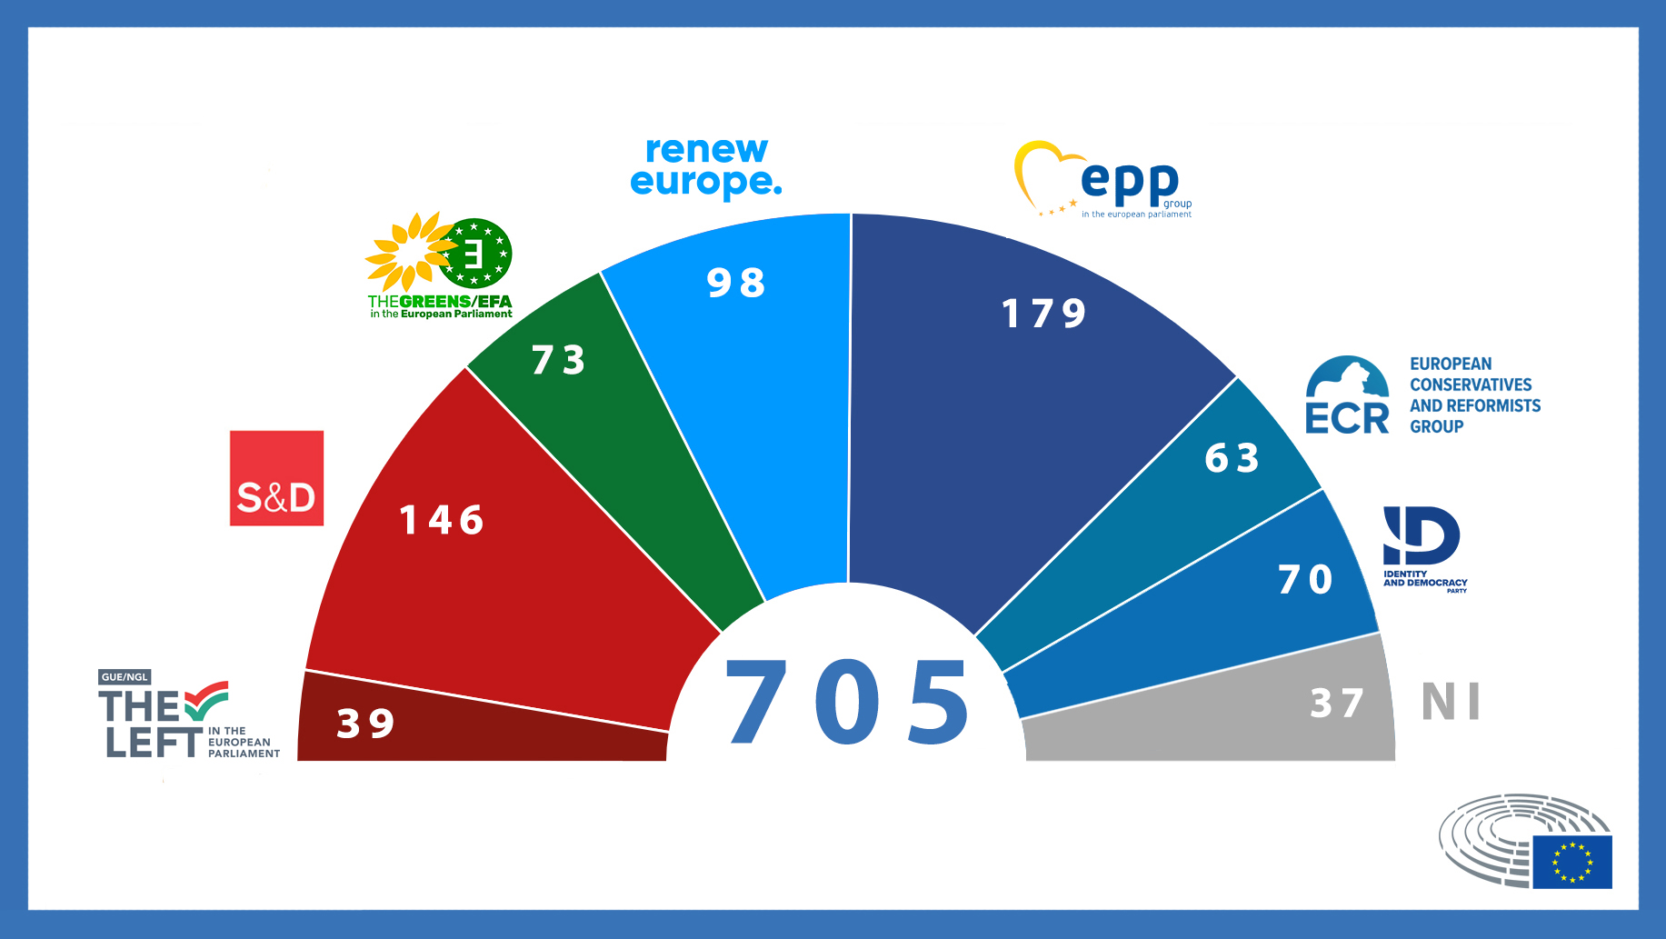
Political groups EP 2022

Slide 26
Differences between a national parliament and the EP
SIMILARITIES
Direct election
Legislative competence
Investigative powers
Possibility of overturning the executive power
DIFFERENCES
Clear differentiation of parliamentary majority and opposition
Elects the government
Possibility of dissolution by the executive

Slide 27
Differences and similarities between a national parliament and the EP
The EP – a hybrid parliament
Lacks the distinction between majority-opposition because it does not elect the government
Needs to look for absolute majorities to counteract the Council → consensual policies
Weak party formations – dominance of national differences

